Slide 1
Admin Toolkit Slides

Slide 2
VKRP is a set of coordinated assessments
Literacy (incorporated from Virginia Literacy Partnerships), mathematics, self-regulation, and social skills are combined to provide teachers with a more comprehensive picture of students’ skills at the beginning and end of kindergarten and the beginning and end of pre-kindergarten (with an optional mid-year timepoint).
VKRP is a reporting system
Provides detailed and integrated information about students’ skills at the student (for teachers and families), classroom, school, division, region, and state levels.
VKRP is a set of instructional resources
Supports teachers and families to understand students’ skill levels and to use instructional practices to support children’s learning and growth.
Notes:
VKRP provides a set of assessments that shine a spotlight on school readiness and student learning growth to empower teachers, education leaders, and families.
VKRP is:
Virginia standards-aligned
Multi-year school readiness assessment system (3-year-old through K)
Produces actionable information to guide decisions at the student, classroom, school and division levels to support student learning
VKRP provides a very robust reporting system --automated reporting at the student (for a educators and for families), classroom, school, division, region, and state)
Manual reporting process for division and regional reports, state report once a year

Slide 3
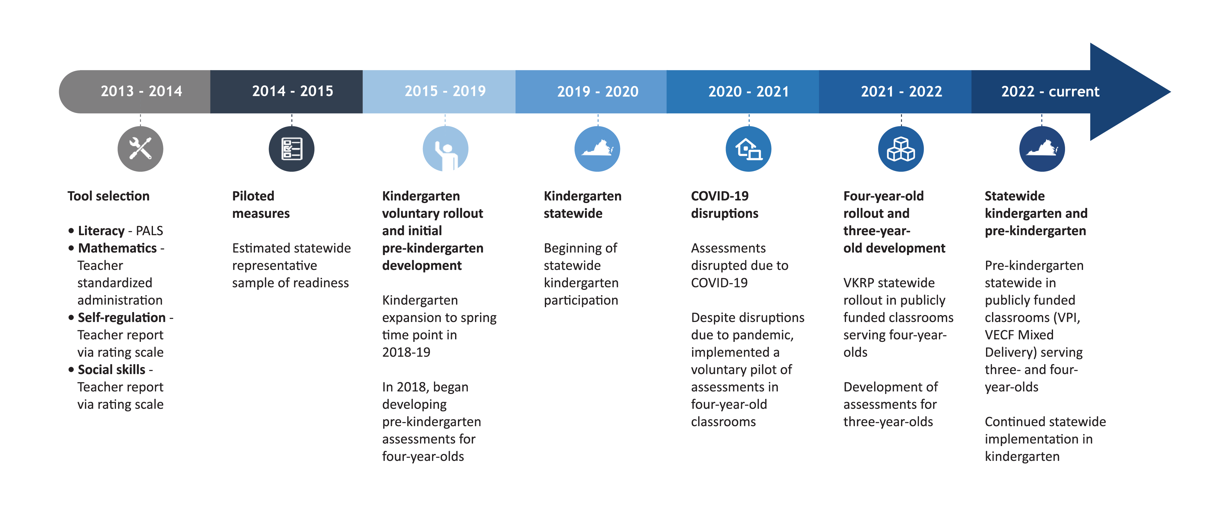
History of VKRP
Notes:
The team at UVA has been working with school divisions and Pre-K programs for many years to develop the VKRP assessments, reports, resources for Kdg and Pre-K versions of these components.
In 2019, all public school kindergarten classrooms across the state began using VKRP
The 2021-2022 school year, began the statewide rollout of VKRP Pre-k publicly funded programs.
In 2022-2023, we added assessments for 3-year-old classrooms
This year, a Mid-Year assessment timepoint will be available as an optional timepoint for all grade levels.

Slide 4
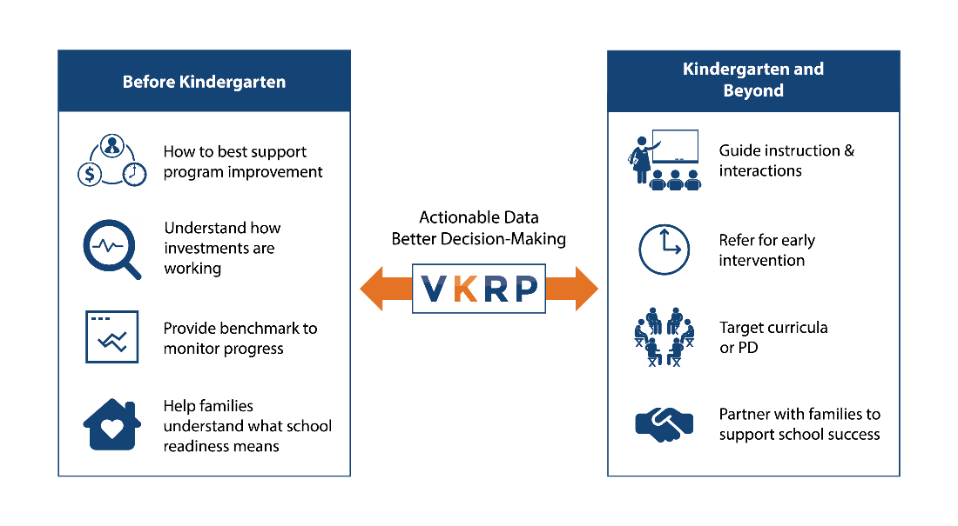
How Statewide Readiness Data Can be Used
Notes:
VKRP data help key players in classrooms, schools, divisions, and government make data-informed decisions about how to best meet the needs of Virginia’s youngest students and to invest strategically in early childhood initiatives. VKRP and other sources of early childhood education data can be used to identify readiness gaps, track system-level trends, and inform effective allocation of education resources. However, VKRP was not designed to be reliable within a high-stakes accountability environment and is not suited for use as a specific consequence to students, teachers, or schools/programs.
Detailed, actionable information
Better meet students at their current skill level
Refer a student for additional assessment
Provide early intervention services
Resources provide guidance on what to do next
Information on the what the skill is and how it develops
Strategies and activities
Identify areas of need
Is there variability across skills?
Do certain schools or classrooms stand out?
Many children arriving with key foundational skills and vice versa
Inform decisions about professional development for teachers
Provide more targeted PD to teachers or schools based on the data
Data to help determine if that training was useful in supporting children's’ skills
Understand how experiences prior to kindergarten are supporting children’s skills
e.g., Preschool experience, home visiting

Slide 5
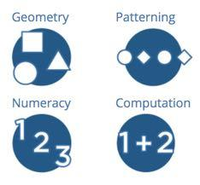
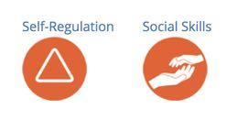
VKRP Assessments
Literacy Virginia Language & Literacy Screener: Pre-k (VALLS: Pre-k) Virginia Language & Literacy Screener: Kindergarten (VALLS: Kindergarten) | Mathematics Early Mathematics Assessment System (EMAS): EMAS Pre-k 3 EMAS Pre-k 4 EMAS K | Self-Regulation & Social Skills Child Behavior Rating Scale (CBRS): Utilized for Pre-k 3 – K | Mental Health Well-Being Note. Items capturing teachers’ report of students’ mental well-being were added in fall of 2020. These items are not part of the overall readiness score.
Notes:
Kindergarten or school readiness spans multiple domains— including language, literacy, math, science, cognition, self-regulation, social skills, physical health, and gross motor skills.
And… children’s skills do not develop in isolation but rather they are developed through children’s early experiences at home, school, and in the community.
VKRP is not fully comprehensive (for example—it does not measure language—although VLP is adding a language assessment). It does not measure all domains and even within each domain it is does not measure every aspect.
However, these measures DO provide reliable and valid data across indicators known to predict school success in the short and long term (literacy, social skills, mathematics, and self regulation). These measures also provide a purposeful equal emphasis on academics and social-emotional skills.

Slide 6
VKRP – Literacy – Virginia Literacy Partnerships (VLP)
Virginia Language & Literacy Screener: Kindergarten (VALLS: Kindergarten)
Virginia Language & Literacy Screener: Pre-K (VALLS: Pre-K)
Notes:
The Virginia Language & Literacy Screening System includes language and literacy screeners for kindergarten and pre-k. Provided by the Virginia Literacy Partnerships, VALLS: Pre-K and VALLS: Kindergarten are screeners given by children’s classroom teachers, instructional assistants, and/or other members of school personnel (e.g., math leads, literacy specialists).

Slide 7
VKRP – Mathematics
The Early Mathematics Assessment System (EMAS)
The teacher:
Assesses skills in the areas of Numeracy, Computation, Patterning, and Geometry.
Administers assessment to students individually using a flipbook and specific manipulatives.
Enters and records the students’ responses as they administer the assessment into the VKRP application.
Notes:
The EMAS is a reliable and valid measure of mathematics – teachers work one on one with a child using math manipulatives and materials to assess their skills.

Slide 8
VKRP – Self-Regulation, Social Skills, and Mental Health Well-being
The Child Behavior Rating Scale (CBRS)
The teacher:
Observes their students’ behavior and interactions with peers and adults in the school setting.
Completes a short rating scale that measures teachers’ perceptions of students’ self-regulation and social skills.
Responds to five items that focus on students’ mental health well-being and one item regarding concerns about a student’s social-emotional well-being.
Notes:
The CBRS is a reliable and valid measure of self-regulation and social skills – a published measure that has been used in other states across the US to measure these skills in pre-kindergarten, kindergarten, and into elementary school. Teachers observe students for 4-6 weeks before completing the rating scale, which takes about 3 minutes per student within the online assessment system.
Mental Health Well-being items were added beginning in fall 2020 to ascertain student mental health and teacher overall concern regarding a student’s mental health well-being.

Slide 9
Defining Kindergarten Readiness for Summative Purposes
For summative purposes, kindergarten students’ scores are categorized as ready or meeting the fall overall benchmark and meeting the spring overall benchmark if their score on the assessments indicate that they demonstrate the minimally expected skills for the fall or the spring of kindergarten in the areas of literacy, mathematics, self-regulation, and social skills.
If a kindergarten student’s score does not indicate that they demonstrate the minimally expected skill in one or more areas at the respective timepoint (fall or spring), their score is categorized as not ready or below the benchmark (fall) and below the benchmark (spring).
Notes:
For purposes of VKRP
Ready = foundational skills in all areas
Not Ready = Lacking foundational skills in one or more areas
Consistent with how readiness is defined in the research

Slide 10
Reports
Classroom Overview Examples
Family Information Report Examples

Slide 11
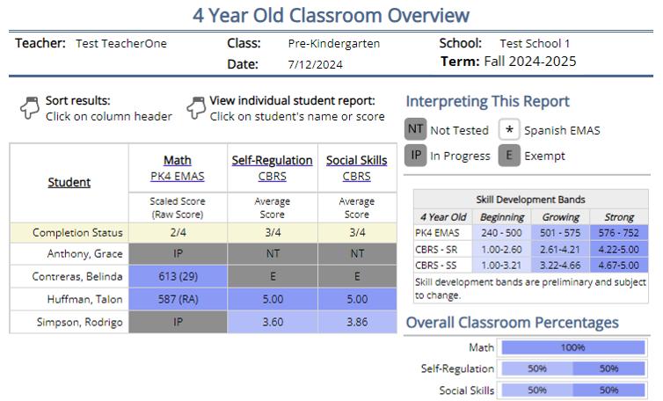
Reports: Classroom Overview Pre-kindergarten
Easy to interpret
Interactive
Printable
Exportable
Linked to instructional resources
Notes:
Several different types of VKRP reports are provided.
As we see here – Pre-K Teachers have a Classroom level report that shows all students and their scores on the EMAS and CBRS self-regulation and social skills.
Pre-kindergarten student scores are color-coded based on their skill development range – Beginning, Growing, and Strong
Teachers can access other reports at the classroom level as well as student level reports.
Program and School level staff have access to reports and data exports as well.

Slide 12
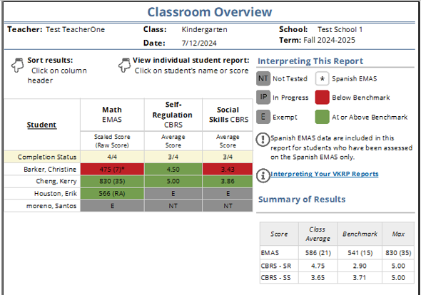
Reports: Classroom Overview Kindergarten
Easy to interpret
Interactive
Printable
Exportable
Linked to instructional resources
Notes:
Several different types of VKRP reports are produced
As we see here – Kindergarten Teachers have a Classroom level report that shows all students and their scores on the EMAS and CBRS self-regulation and social skills.
Kindergarten student scores are color-coded based on their meeting the benchmark (green) or not (red).
Teachers have additional reports at the classroom level as well as student level.
School and Division level staff have access to reports and data exports as well.

Slide 13
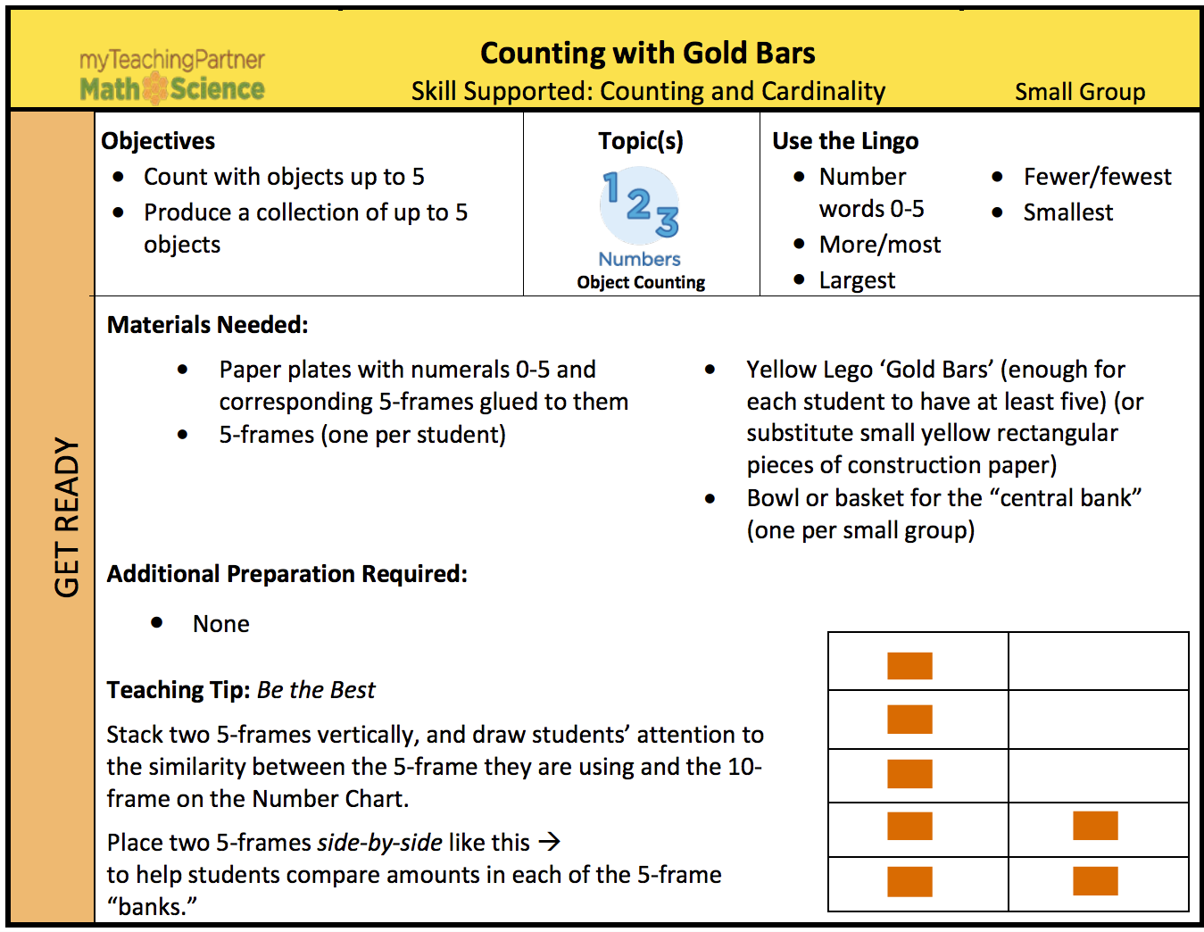
Teacher Resources – Skill Guides
Instructional Resources located at the bottom right corner of the report
Notes:
Numerous resources and activities are available to teachers within the VKRP web portal. The Key Skill Overviews go into depth about how a skill develops, where students might have difficulty, and how to help them. In addition, the activities and strategies provided include how to support students who are just learning the skill as well as ways to challenge students to take the skill further.

Slide 14
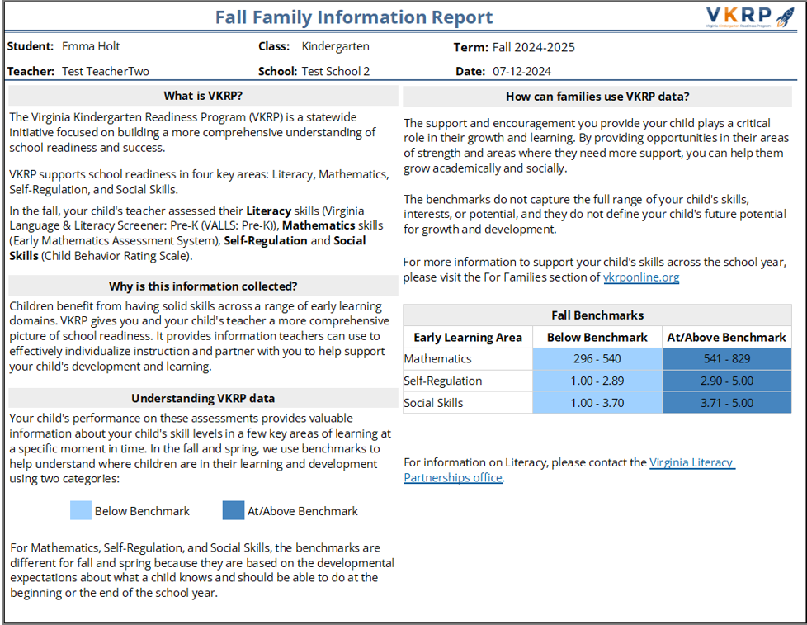
Reports: Family Information Report – Kindergarten
Notes:
Teachers have access to a summary report to share with families – the Family Information Report.
For kindergarten the report includes information about the VKRP and assessments on page one

Slide 15
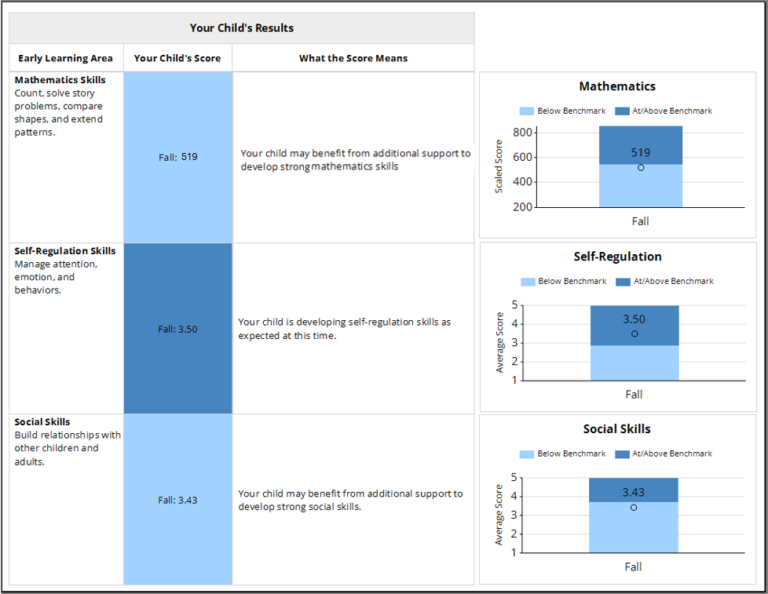
Reports: Family Information Report – Kindergarten
Notes:
and the student’s scores on the math, self-regulation, social skills domains on page 2.

Slide 16
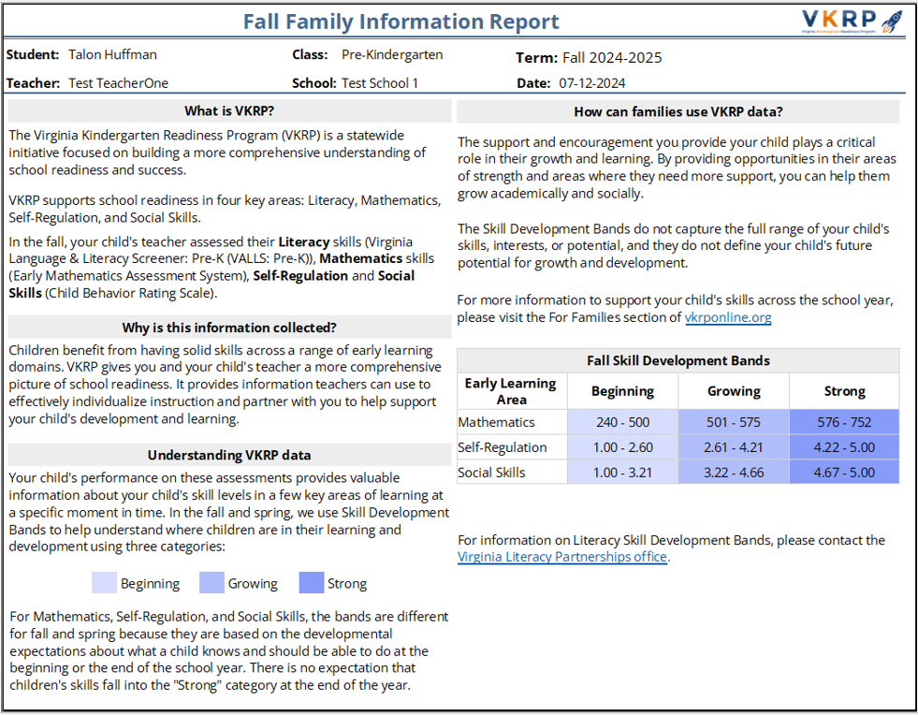
Reports: Family Information Report – Pre-Kindergarten
Notes:
A similar report is available for pre-kindergarten teachers to share with families.

Slide 17
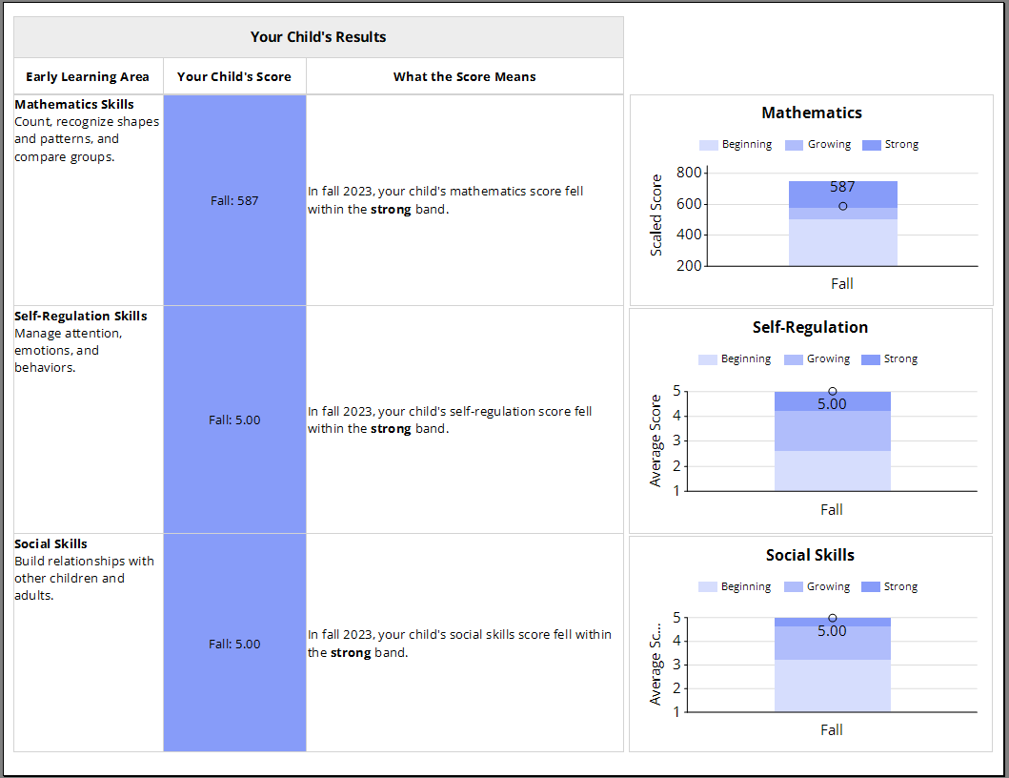
Reports: Family Information Report – Pre-Kindergarten

Slide 18
Benefits for Teachers
Understands students’ strengths and areas of needed support
Student-level reports tied to recommended instructional resources help teachers determine how to individualize instruction for students.
Classroom-level reports inform instructional plans.
Family-friendly reports and resources to help teachers communicate with families and caregivers about student progress and ways to support skills at home.

Slide 19
Benefits for Families
Understand your child’s skills in a variety of learning domains
Know what skills you can support and help your child with at home
Collaborate with your child’s teachers to identify home learning activities
Benefits for Other Stakeholders
Programs and Schools:
Helps program, school, and division leaders determine where resources are needed the most
State-Level Policymakers:
VKRP and other sources of early childhood education data can be used to identify how best to support school readiness, track system-level trends, and inform effective allocation of education resources

Slide 20
For More Information
www.vkrponline.org
866-301-8278
vkrp@virginia.edu

